Slide 1
Load in EPM
Load education series 2025

Slide 2

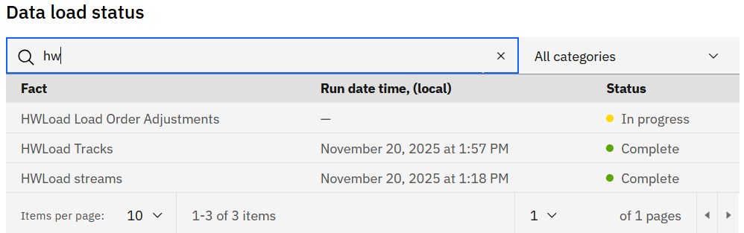
Load in EPM
One way of reporting Load data is via EPM.
Data are ingested into EPM from 4 sources with 3 separate ingestion runs:
HWLoad Order Adjustments from MEASUREMENT (FNP.WW_MEAS) table,
ORDER (FNP.WW_ORD_CUR) table,
HWLoad streams from Stream cube &
HWLoad Tracks from Tracks cube.
Data are updated daily (workdays, exceptionally weekend updates, scheduled in Load Calendar)
Update starts at 6AM EST, takes about 2 hrs to complete
There is no special access needed (Load is part of the basic EPM package)
Load run status can be checked on EPM Status page https://production.epm-web-platform.dal.app.cirrus.ibm.com/app/
Link to the HW Load Report: https://ibm.biz/HW-Load
Link to the HW Load Tracks: ibm.biz/HW-Tracks
More details about HW Load Report in EPM can be found in the recorded showcase: https://ibm.ent.box.com/folder/351759678411

Slide 3
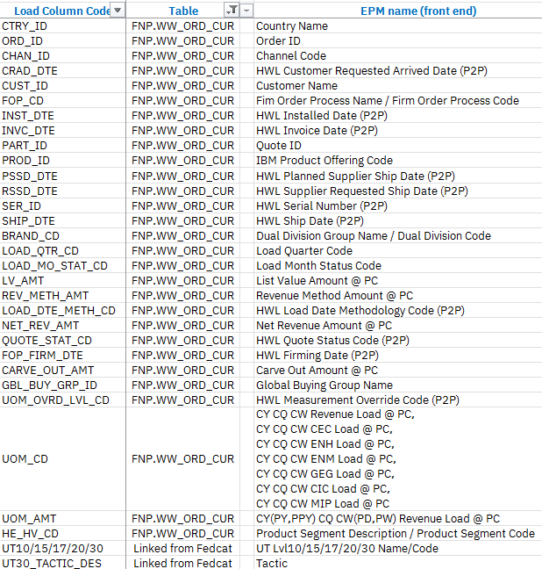
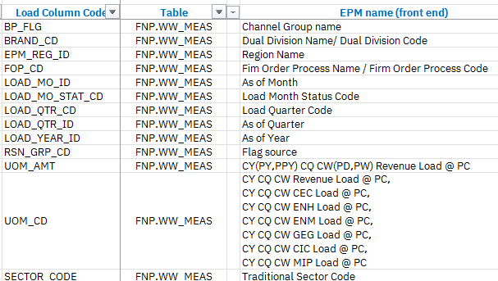
Bridging of fields from Load DB2 to Load EPM

